Slide 1



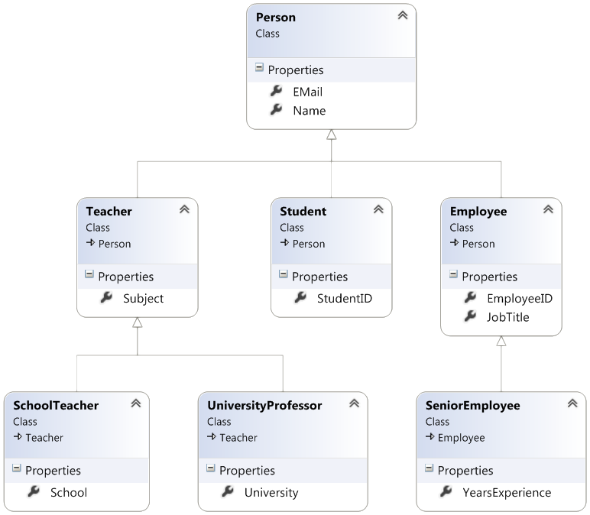

OOP Principles
Inheritance, Abstraction, Encapsulation, Polymorphism
SoftUni Team
Technical Trainers
Software University
http://softuni.bg

Slide 2

Table of Contents
Fundamental Principles of OOP
Inheritance
Class Hierarchies
Inheritance and Access Levels
Abstraction
Abstract Classes
Interfaces

Slide 3


Table of Contents (2)
Encapsulation
Polymorphism
Class Hierarchies: Real World Example
Cohesion and Coupling

Slide 4

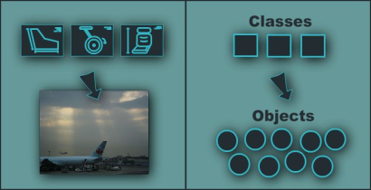
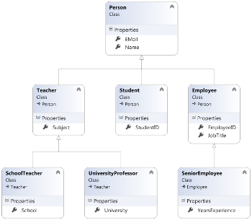
Fundamental Principles of OOP
Object-Oriented
Notes:
(c) 2006 National Academy for Software Development - http://academy.devbg.org*
4##

Slide 5
Fundamental Principles of OOP
Inheritance
Inherit members from parent class
Abstraction
Define and execute abstract actions
Encapsulation
Hide the internals of a class
Polymorphism
Access a class through its parent interface

Slide 6
Inheritance
Notes:
(c) 2006 National Academy for Software Development - http://academy.devbg.org*
6##

Slide 7
Classes and Interfaces
Classes define attributes (data) and behavior
Fields, properties, methods, etc.
Methods contain code for execution
Interfaces define a set of operations (contract)
Empty methods and properties, left to be implemented later
public class Labyrinth { public int Size { get; set; } }
public interface IFigure { void Draw(); }

Slide 8
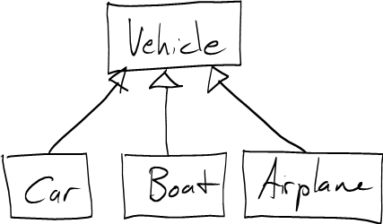
Inheritance
Inheritance allows child classes to inherit the characteristics of an existing parent (base) class
Attributes (fields and properties)
Operations (methods)
A child class can extend the parent class
Add new fields and methods
Redefine methods (override existing behavior)
A class can implement an interface by providing implementation for all its methods

Slide 9
Types of Inheritance
Inheritance terminology
base class /
parent class
derived class
inherits
class
implements
interface
derived interface
extends
base interface

Slide 10

Inheritance – Benefits
Inheritance has a lot of benefits
Extensibility
Reusability (code reuse)
Provides abstraction
Use inheritance for buidling is-a relationships
E.g. dog is-a animal (dogs are kind of animals)
Don't use it to build has-a relationship
E.g. dog has-a name (dog is not a kind of name)
Notes:
Extensibility / Polymorphism: New functionality may be easily plugged in without changing existing classes as long the new plug-in classes extend given base classes.
Reusability: For a set of similar applications a framework can be defined using a core set of classes that are to be extended by classes that fill in the application-dependent part.
Information Hiding: If a more general class using a simpler contract is sufficient, details from extending classes may be hidden to some of the client classes. This allows them to be more independent from possible changes and diminishes the load of contracts that must be understood by a reader of these client classes.
(c) 2006 National Academy for Software Development - http://academy.devbg.org*
10##

Slide 11
Inheritance
Base (parent) class
The class giving its members to its child class
Derived (child) class
The class taking members from its base class
Inheritance implicitly takes all members from another class
All fields, methods, properties, events, …
Some members could be inaccessible: private members will be hidden in the derived class
Base
Derived

Slide 12
Inheritance – Example
Base class
Person
+Name: string
+Address: string
Derived class
Derived class
Employee
Student
+Company: string
+Salary: decimal
+School: string

Slide 13
Class Hierarchies
Inheritance leads to hierarchies of classes and / or interfaces in an application:
Game
SinglePlayerGame
MultiplePlayersGame
Minesweeper
Solitaire
BoardGame
…
…
Chess
Backgammon

Slide 14
Inheritance in C#
A C# class can inherit only one base class
E.g. IOException derives from SystemException
Which derives from Exception
A C# class can implement multiple interfaces
That's how C# supports multiple inheritance
E.g. List<T> implements IList<T>, ICollection<T>, IEnumerable<T>
An interface can extend several interfaces
E.g. IList<T> extends ICollection<T> and IEnumerable<T>

Slide 15


How to Define Inheritance?
Use class DerivedClass : BaseClass
Use the keyword base to invoke the parent constructor
public class Shape
{ … }
public class Circle : Shape
{ … }
public Circle (int x, int y)
: base(x)
{ … }

Slide 16
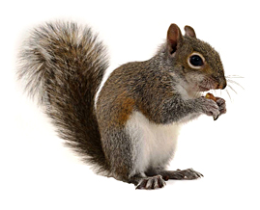
Simple Inheritance Example
public class Mammal
{
public Mammal(int age)
{
this.Age = age;
}
public int Age { get; set; }
public void Sleep()
{
Console.WriteLine("Shhh! I'm sleeping!");
}
}

Slide 17

Simple Inheritance Example (2)
public class Dog : Mammal
{
public Dog(int age, string breed)
: base(age)
{
this.Breed = breed;
}
public string Breed { get; set; }
public void WagTail()
{
Console.WriteLine("Tail wagging...");
}
}

Slide 18
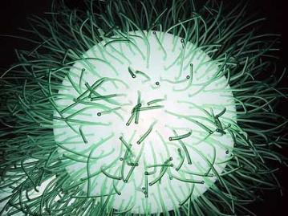

Simple Inheritance
Live Demo

Slide 19
Access Modifiers
Access modifiers in C#
public – access is not restricted
private – access is restricted to the containing type
protected – access is limited to the containing type and all types derived from it
internal – access is limited to the current assembly (C# project)
protected internal – access is limited to the current assembly or types derived from the containing class

Slide 20
Inheritance and Access Modifiers
class Creature
{
protected string Name { get; private set; }
private void Talk()
{
Console.WriteLine("I am creature ...");
}
protected void Walk()
{
Console.WriteLine("Walking ...");
}
}
class Mammal : Creature
{
// base.Talk() cannot be invoked here (it’s private)
// this.Name can be read but cannot be modified here
}

Slide 21
Inheritance and Access Modifiers (2)
class Dog : Mammal
{
public string Breed { get; private set; }
// base.Talk() cannot be invoked here (it is private)
}
class InheritanceAndAccessibility
{
static void Main()
{
Dog joe = new Dog(6, "Labrador");
Console.WriteLine(joe.Breed);
// joe.Walk() is protected and can not be invoked
// joe.Talk() is private and can not be invoked
// joe.Name = "Rex"; // Cannot modify Name (private setter)
// joe.Breed = "Shih Tzu"; // Cannot modify Breed (private setter)
}
}

Slide 22

Inheritance and Access Modifiers
Live Demo

Slide 23
Inheritance: Important Aspects
Structures cannot be inherited
In C# there is no multiple inheritance
Only multiple interfaces can be implemented
Static members are also inherited
Constructors are not inherited
Inheritance is a transitive relation
If C is derived from B, and B is derived from A → C inherits A

Slide 24
Inheritance: Important Features
When a derived class extends its base class
It can freely add new members
Cannot remove derived members
Declaring new members with the same name or signature hides the inherited ones
A class can declare virtual methods and properties
Derived classes can override their implementation
E.g. Object.ToString() is virtual method

Slide 25
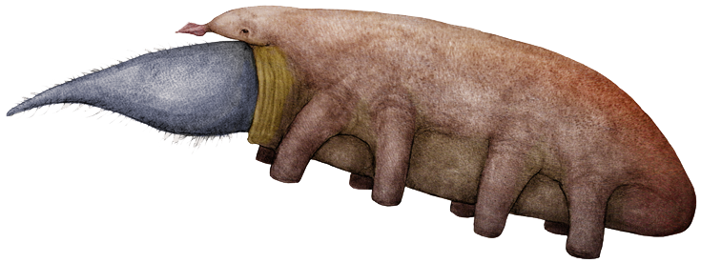
Abstraction
Notes:
(c) 2006 National Academy for Software Development - http://academy.devbg.org*
25##

Slide 26

Abstraction
Abstraction means ignoring irrelevant features, properties, or functions and emphasizing the relevant ones ...
... relevant to the project we develop
With an eye to future reuse in similar projects
Abstraction helps managing complexity
"Relevant" to what?

Slide 27
Abstraction (2)
Abstraction is something we do every day
Looking at an object, we see those things that have meaning to us
And ignore all others
Represent a complex reality with a simplified model
In a bank application, customers have name, phone and address
Don't have hair color and favorite drink
In a hair-styling studio, customers have hair color
In the pub, customers have favorite drink

Slide 28

Abstraction in OOP
Several ways to achieve abstraction in OOP:
Interfaces
Abstract classes
Interface
IControl
+Click()
Abstract class
ButtonBase
Concrete class
+Color : Color
Button
RadioButton
CheckBox

Slide 29
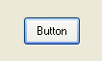
Example: Abstraction in .NET Framework
System.Object
System.MarshalByRefObject
System.ComponentModel.Component
System.Windows.Forms.Control
System.Windows.Forms.ButtonBase
System.Windows.Forms.Button

Slide 30
Interfaces
An interface defines a set of operations (methods) that a given object should support
Also called "contract" for providing a set of operations
Defines abstract behavior, abstract capabilities
Interfaces provide abstractions
You invoke the abstract action
Without worrying how it is implemented internally
Without worrying what is the actual class which calls it

Slide 31
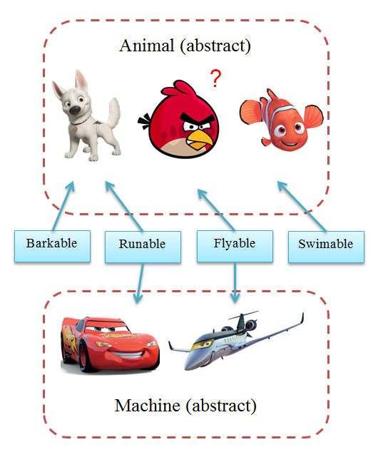
Interfaces – Example
Classes
Interfaces

Slide 32
Interfaces in C#
Interfaces in C# describe a prototype of group of methods (operations), properties and events
Can be implemented by a class or structure
Define only the signature of the methods / properties
No concrete implementations are provided
Can be used to define abstract data types
Can be inherited (extended) by other interfaces
Cannot be instantiated

Slide 33
Interfaces – Example
public interface IShape
{
void SetPosition(int x, int y);
int CalculateSurface();
}
public interface IMovable
{
void Move(int deltaX, int deltaY);
}
public interface IResizable
{
void Resize(int weight);
void Resize(int weightX, int weightY);
void ResizeByX(int weightX);
void ResizeByY(int weightY);
}

Slide 34
Interface Implementation
Classes and structures can implement (support) one or several interfaces
Implementer classes must implement all interface methods
Or should be declared abstract
class Rectangle : IShape
{
public void SetPosition(int x, int y) { … }
public int CalculateSurface() { … }
}

Slide 35
Interface Implementation (2)
class Rectangle : IShape, IMovable
{
private int x, y, width, height;
public void SetPosition(int x, int y) // IShape
{
this.x = x;
this.y = y;
}
public int CalculateSurface() // IShape
{
return this.width * this.height;
}
public void Move(int deltaX, int deltaY) // IMovable
{
this.x += deltaX;
this.y += deltaY;
}
}

Slide 36

Interfaces and Implementation
Live Demo

Slide 37
Interfaces, Properties and Events
Interfaces in C# can define properties and events
Not just methods
public interface IPerson
{
DateTime DateOfBirth { get; set; }
int Age { get; }
ZodiacSign ZodiacSign { get; }
event EventHandler Changed;
}

Slide 38
Abstract Classes
Abstract classes are partially defined classes
Represent some abstraction, not particular class
Mix between class and interface
Can be partially implemented or fully unimplemented
Not implemented methods are declared as abstract
Abstract classes cannot be directly instantiated
Child classes should implement all abstract methods
Or should be declared as abstract as well

Slide 39
Abstract Classes (2)
Abstract methods are empty methods without implementation
The implementation is intentionally left for the descendent classes
When a class contains at least one abstract method, it should be defined as abstract
Abstract classes model abstract concepts
E.g. person, object, item, movable object
Concrete classes model concrete objects
E.g. dog, cat, frog, kitten

Slide 40
Abstract Class – Example
abstract class MovableShape : IShape, IMovable
{
private int x, y;
public void Move(int deltaX, int deltaY)
{
this.x += deltaX;
this.y += deltaY;
}
public void SetPosition(int x, int y)
{
this.x = x;
this.y = y;
}
public abstract int CalculateSurface();
}

Slide 41
Interfaces vs. Abstract Classes
C# interfaces are like purely abstract classes, but:
Interfaces cannot hold methods with implementation
All interface methods are abstract
Interface members do not have scope modifiers
Their scope is assumed public
But public is not specified explicitly
Cannot define fields, constants, inner types and constructors

Slide 42
Abstract Classes – Example
public abstract class Animal : IComparable<Animal>
{
// Abstract methods
public abstract string GetName();
public abstract int Speed { get; }
// Non-abstract method
public override string ToString()
{
return "I am " + this.GetName();
}
// Interface method
public int CompareTo(Animal other)
{
return this.Speed.CompareTo(other.Speed);
}
}

Slide 43
Abstract Classes – Example (2)
public class Turtle : Animal
{
public override int Speed { get { return 1; } }
public override string GetName() { return "turtle"; }
}
public class Cheetah : Animal
{
public override int Speed { get { return 100; } }
public override string GetName() { return "cheetah"; }
}

Slide 44
Abstract Classes
Live Demo

Slide 45
Abstract Data Types
Abstract Data Types (ADT) are data types defined by a set of operations (as interface)
Examples:
IList<T> in .NET
List<E> in Java
«interface»
IList<T>
+Add(item : Object)
+Remove(item : Object)
+Clear()
…
LinkedList<T>
List<T>

Slide 46

Exercise in Class

Slide 47
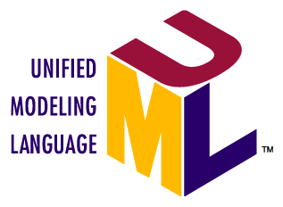
Inheritance Hierarchies
Using inheritance we can create inheritance hierarchies
Easily represented by UML class diagrams
UML class diagrams
Classes are represented by rectangles
Holding their methods and data
Relations between classes are shown as arrows
Closed triangle arrow means inheritance
Other arrows mean some kind of associations

Slide 48
UML Class Diagram – Example
interface
Shape
struct
ISurfaceCalculatable
Point
#Position:Point
+CalculateSurface:float
+X:int
+Y:int
+Point
Square
Rectangle
struct
Color
-Size:float
-Width:float
-Height:float
+RedValue:byte
+Square
+GreenValue:byte
+CalculateSurface:float
+Rectangle
+BlueValue:byte
+CalculateSurface:float
+Color
FilledSquare
FilledRectangle
-Color:Color
-Color:Color
+FilledSquare
+FilledRectangle

Slide 49
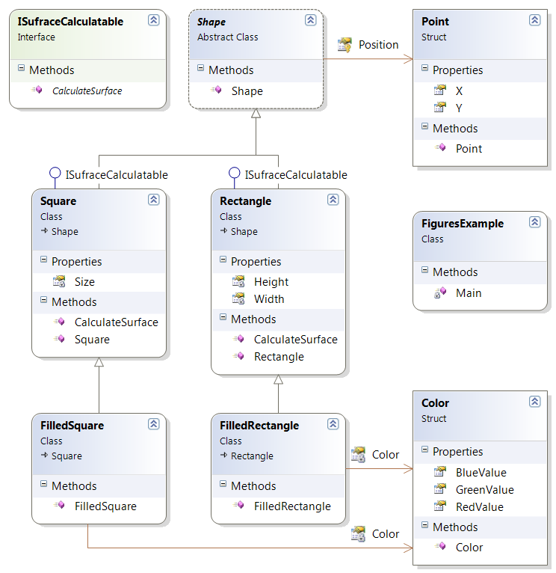
Class Diagrams in Visual Studio
Live Demo

Slide 50

Summary
Inheritance allows extending / copying the behavior of classes
Inheriting data (fields / properties)
Inheriting functionality (methods)
Reusing the existing code
Abstraction models class behavior
Achieved through interfaces and abstract classes
Interfaces define a set of methods (contracts)
Abstract classes are mixes between class and interface

Slide 51

Encapsulation

Slide 52
Encapsulation
Encapsulation hides the implementation details
Class announces only a few operations (methods) available for its clients – its public interface
All data members (fields) of a class should be hidden
Accessed via properties (read-only and read-write)
No interface members should be hidden
Encapsulation == hide (encapsulate) data behind constructors and properties

Slide 53
Encapsulation – Example
Data fields are private
Constructors and accessors are defined (getters and setters)
Person
-name : string
-age : int
+Person(string name, int age)
+Name : string { get; set; }
+Age : TimeSpan { get; set; }

Slide 54
Encapsulation in C#
Fields are always declared private
Accessed through properties in read-only or read-write mode
Properties perform checks to fight invalid data
Constructors are declared public
Constructors perform checks to keep the object state valid
Interface methods are always public
Not explicitly declared with public
Non-interface methods are declared private / protected

Slide 55
Encapsulation – Benefits
Ensures that structural changes remain local
Changing the class internals does not break any outside code
Allows changing the internal class implementation
Encapsulation allows adding logic when accessing object data
E.g. validations on when a property is modified
E.g. notifications about changes (allows data binding)
Hiding implementation details reduces complexity
Easier maintenance

Slide 56
Encapsulation – Example
public class Person
{
private string name;
public string Name
{
get { return this.name; }
set
{
if (value == null)
throw new ArgumentException("Invalid person name.");
this.name = value;
}
}
}
The field "name" is encapsulated (hidden)

Slide 57

Encapsulation
Live Demo
Notes:
(c) 2006 National Academy for Software Development - http://academy.devbg.org*
57##

Slide 58
Exercise in Class

Slide 59
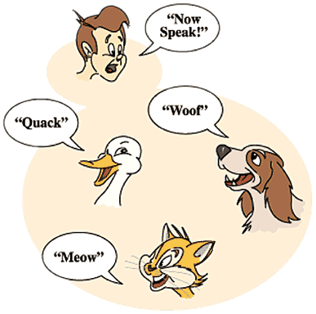
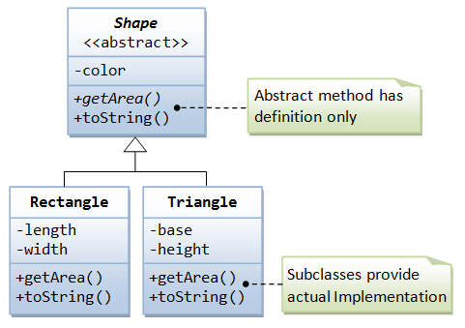
Polymorphism
Notes:
(c) 2006 National Academy for Software Development - http://academy.devbg.org*
59##

Slide 60
Polymorphism
Polymorphism = the ability to take more than one form (objects have more than one type)
A class can be used through its parent interface
A child class may override (change) some of the parent's methods
Polymorphism allows invoking abstract operations
Defined in the base class / interface
Implemented in the child classes
Declared as abstract or virtual or inside an interface

Slide 61
Polymorphism – Example
Abstract class
Figure
Abstract action
+CalcSurface() : double
Concrete class
Square
Circle
-x : int
-y : int
-size : int
-x : int
-y : int
-radius : int
Overriden action
Overriden action
+CalcSurface()
+CalcSurface()
public override double CalcSurface()
{
return size * size;
}
public override double CalcSurface()
{
return Math.PI * radius * raduis;
}

Slide 62
Polymorphism – Example (2)
abstract class Figure
{
public abstract double CalcSurface();
}
class Square
{ public override double CalcSurface() { return size * size; } }
class Circle
{ public override double CalcSurface() { return PI * r * r; } }
Figure f1 = new Square(…);
Figure f2 = new Circle(…);
double surface = f1.CalcSurface(); // Call Square.CalcSurface()
double surface = f2.CalcSurface(); // Call Circle.CalcSurface()

Slide 63
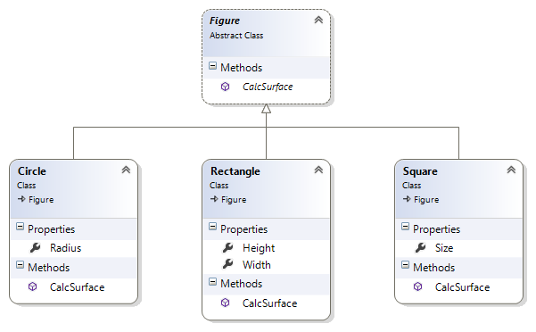
Polymorphism
Live Demo

Slide 64
Polymorphism – Why?
Why handle an object of given type as object of its base type?
To invoke abstract operations implemented in the child classes
To mix different data types in the same collection
E.g. List<Figure> can hold Circle and Rectangle objects
To pass more specific object to a method that expects a more generic type (e.g. SchoolStudent instead of Student)
To declare a more generic field which will be initialized and "specialized" later (in a subclass)

Slide 65
Virtual Methods
A virtual method is:
Defined in a base class and can be changed (overridden) in the descendant classes
Virtual methods are declared through the keyword virtual
Methods declared as virtual in a base class can be overridden using the keyword override
public virtual void Draw() { … }
public override void Draw() { … }

Slide 66
Virtual Methods – Example
abstract class Figure
{
public virtual void Draw()
{
Console.WriteLine(
"I am a figure of type: {0}", this.GetType().Name);
}
}
class Circle : Figure
{
public override void Draw()
{
Console.WriteLine("I am a circle");
}
}

Slide 67
Calling Base Virtual Methods – Example
class Circle : Figure
{
public override void Draw()
{
Console.WriteLine("I am a circle:");
Console.WriteLine(" --- ");
Console.WriteLine("| |");
Console.WriteLine(" --- ");
}
}
class SpecialCircle : Circle
{
public override void Draw()
{
Console.WriteLine("I am a special circle.");
base.Draw();
}
}

Slide 68

Virtual Methods
Live Demo

Slide 69
More about Virtual Methods
Abstract methods are purely virtual
If a method is abstract → it is virtual as well
Abstract methods are designed to be changed (overridden) later
Interface members are also purely virtual (abstract)
They have no default implementation and are designed to be overridden in descendant classes
Virtual methods can be hidden through the new keyword:
public new double CalculateSurface() { return … }

Slide 70

The override Modifier
Use override to modify a method or property
Provide a replacement implementation for the inherited member
You cannot override a non-virtual or static method
The overridden base method must be one of the following:
virtual
abstract
override
(interface method)

Slide 71
Polymorphism – How It Works?
Polymorphism ensures that the appropriate method of the subclass is called through its base class' interface
In C++, C#, Java polymorphism is implemented using a technique called "late binding"
The exact method to be called is determined at runtime
Just before performing the call
Applied for all abstract / virtual methods
Note: late binding is a bit slower than normal (early) binding

Slide 72
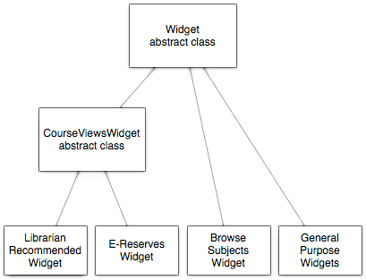
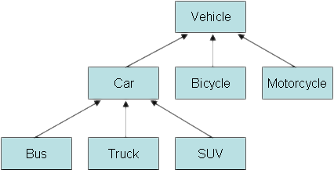
Class Hierarchies: Real World Examples
Notes:
(c) 2006 National Academy for Software Development - http://academy.devbg.org*
72##

Slide 73
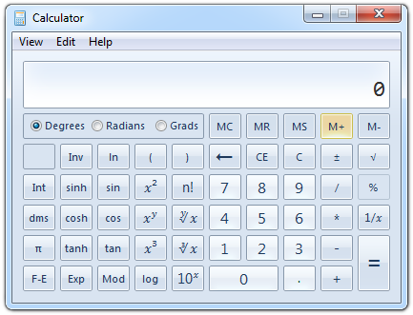
Real World Example: Calculator
Creating an application like the Windows Calculator
Typical scenario for applying the object-oriented approach

Slide 74
Real World Example: Calculator (2)
The calculator consists of controls:
Buttons, text boxes, menus, check boxes, panels, etc.
Class Control – the root of our OO hierarchy
All controls can be painted on the screen
Should implement an interface IPaintable with a method Paint(surface)
Common control properties:
Location, size, text, face color, font, background color, etc.

Slide 75
Real World Example: Calculator (3)
Some controls could contain other (nested) controls inside
E.g. panels and toolbars can hold other controls
Class Container – extends Control, holds a list of child controls
The Calculator itself is a Form
Form is a special kind of Container
Forms hold also border, title, icon and system buttons
The form title is the text derived from Control
How does Calculator paint itself?
Invokes Paint() for all child controls inside it

Slide 76
Real World Example: Calculator (4)
How does a Container paint itself?
Invokes Paint() for all controls inside it (chain of responsibility)
Each control knows how to visualize (paint) itself
Buttons, check boxes and radio buttons are similar
Can be pressed
Can be focused
All buttons could derive from a common parent class AbstractButton

Slide 77
Calculator Classes
«interface»
IPaintable
Paint()
Control
-location
-size
-text
-bgColor
-faceColor
-font
Container
AbstractButton
TextBox
MainMenu
MenuItem
Panel
Form
Button
CheckBox
RadioButton
Calculator

Slide 78
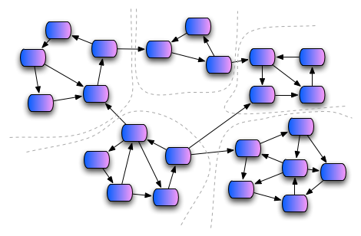
Cohesion and Coupling

Slide 79
Cohesion
Cohesion describes
How closely the routines in a class or the code in a routine support a central purpose
Cohesion must be strong
Well-defined abstractions keep cohesion strong
Classes must contain strongly related functionality and aim for single purpose
Cohesion is a powerful tool for managing complexity

Slide 80



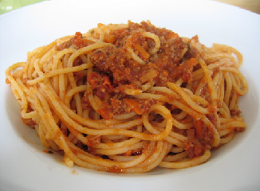
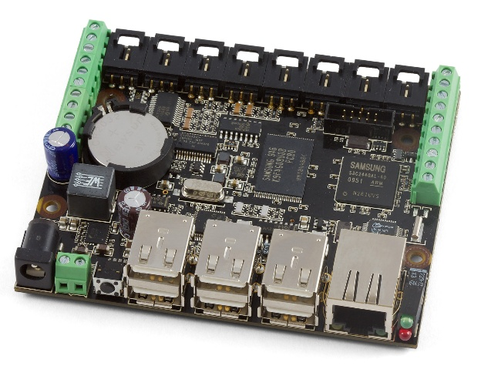
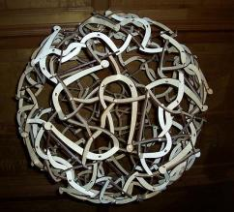
Good and Bad Cohesion
Good cohesion: HDD, CR-ROM, remote control
Bad cohesion: spaghetti code, single-board computer

Slide 81
Strong Cohesion
Strong cohesion (good cohesion) example:
Class Math that has methods:
Sin(), Cos(), Asin(), Sqrt(), Pow(), Exp(), Math.PI, Math.E
double sideA = 40, sideB = 69;
double angleAB = Math.PI / 3;
double sideC = sideA * sideA + sideB * sideB –
2 * sideA * sideB * Math.Cos(angleAB);
double sidesSqrtSum =
Math.Sqrt(sideA) + Math.Sqrt(sideB) + Math.Sqrt(sideC);

Slide 82
Weak Cohesion
Weak cohesion (bad cohesion) example
Class Magic that has these methods:
Another example:
public void PrintDocument(Document d);
public void SendEmail(
string recipient, string subject, string text);
public void CalculateDistanceBetweenPoints(
int x1, int y1, int x2, int y2)
MagicClass.MakePizza("Fat Pepperoni");
MagicClass.WithdrawMoney("999e6");
MagicClass.OpenDBConnection();

Slide 83
Coupling
Coupling describes how tightly a class or a routine is related to other classes or routines
Coupling must be kept loose
Modules must depend little on each other
Or be entirely independent (loosely coupled)
All classes / routines must have small, direct, visible, and flexible relationships to other classes / routines
One module must be easily used by other modules

Slide 84
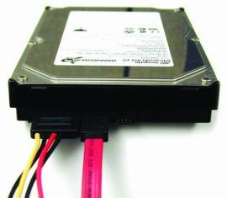
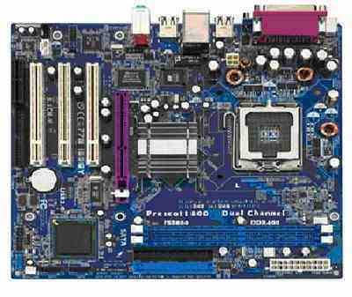
Loose and Tight Coupling
Loose coupling:
Easily replace old HDD
Easily place this HDD to another motherboard
Tight coupling:
Where is the video card?
Can you change the audio controller?

Slide 85
Loose Coupling – Example
class Report : IReport
{
public bool LoadFromFile(string fileName) {…}
public bool SaveToFile(string fileName) {…}
}
class Printer
{
public static int Print(IReport report) {…}
}
class Program
{
static void Main()
{
Report myReport = new Report();
myReport.LoadFromFile(@"C:\Reports\DailyReport.xml");
Printer.Print(myReport);
}
}

Slide 86
Tight Coupling – Example
class MathParams
{
public static double operand;
public static double result;
}
class MathUtil
{
public static void Sqrt()
{
MathParams.result = CalcSqrt(MathParams.operand);
}
}
class MainClass
{
static void Main()
{
MathParams.operand = 64;
MathUtil.Sqrt();
Console.WriteLine(MathParams.result);
}
}

Slide 87
Spaghetti Code
Combination of bad cohesion and tight coupling:
class Report
{
public void Print() {…}
public void InitPrinter() {…}
public void LoadPrinterDriver(string fileName) {…}
public bool SaveReport(string fileName) {…}
public void SetPrinter(string printer) {…}
}
class Printer
{
public void SetFileName() {…}
public static bool LoadReport() {…}
public static bool CheckReport() {…}
}

Slide 88
Summary
Encapsulation hides internal data
Access through constructors and properties
Keeps the object state valid
Polymorphism == using objects through their parent interface
Allows invoking abstract actions overridden in a child class
Strong cohesion == single purpose
Loose coupling == minimal interaction with others

Slide 89









OOP Principles
https://softuni.bg/courses/oop

Slide 90





Free Trainings @ Software University
Software University Foundation – softuni.org
Software University – High-Quality Education, Profession and Job for Software Developers
softuni.bg
Software University @ Facebook
facebook.com/SoftwareUniversity
Software University @ YouTube
youtube.com/SoftwareUniversity
Software University Forums – forum.softuni.bg

